Slide 1
Welcome to Facility and School Registry (FSR) Presentation
Laura Haase
Technology Services

Slide 2
Facility School Registry (FSR)
The database is the backbone of data collected for or about students.
The site itself is foundation for all other data collections.
The facility is then attached to the site.
The school is then attached to the facility so that student reporting can continue as needed by GaDOE and the local school system.

Slide 3
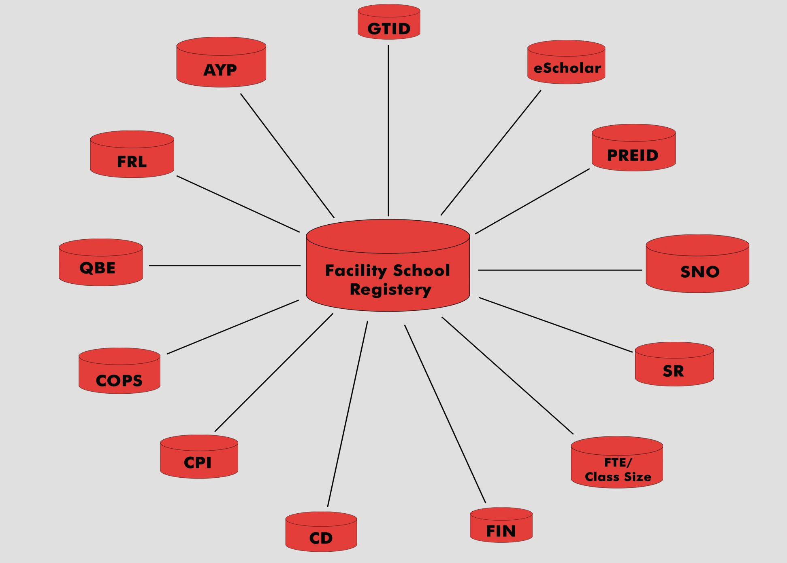

Slide 4
Data Collections
FTE, CPI, Student Record, and School Nutrition and other data are reported by school code.
Capital expenditures are reported by facility code.
Some data is aggregated to the facility level from school code.

Slide 5
Why separate Facility and School Codes?
In the past, there was one code that was used for both facility and school.
For AYP and other reporting reasons, changes to grade levels housed at a facility/school caused a new code to be issued.
All facilities history, funding and planning are tied to the facility code.
It was necessary to establish a facility code separate from a school code to stabilize the facility code.

Slide 6
Obtaining a Site/Tract Code
Submit Site Application and all required documents to the GaDOE Facilities Section
Application and documents will be reviewed
Site/Tract Number and will be generated by the GaDOE Facilities Section
Approval Letter will be sent to Superintendent

Slide 7
Facility Code
A facility code describes the buildings located on a site/tract.
The facility code will be issued by the GaDOE Facilities Section after a copy of a title or warranty deed for the site/tract is received.
The facility code will not change.

Slide 8
School Code
The School Code describes the group of learners housed at a facility. It may change when the group of learners changes.
One facility may house more than one school.
The school code is requested by school system employees through the Portal. It is not needed until the fiscal year the facility is ready to be occupied.

Slide 9
How to Receive a School Code
Submit Facility Site Plan Package to Facilities Services
GaDOE Staff reviews site package
School Requests a School Code through the Facility and School Code Registry
GaDOE Staff visits selected sites and evaluates sites for risk hazards
GaDOE Staff approves a site
GaDOE Staff assign Site and Facility codes
School receives notification of site approval
School changes facility status from proposed to open in the Facility and School Code Registry
GaDOE Staff approves facility code status change
School receives an email notifying the school of their new school code

Slide 10
Site Facility and School codes
Site Code
The code given to the piece of land in which a facility may be located. A site may have multiple facilities located on it.
Facility Code
The code given to a building or group of buildings on one campus.
School Code
A school is a group of learners. The code is given to the school located in a facility. There may be multiple schools located within a building.

Slide 11
What does a Facility Coordinator do?
The Facility Coordinator is given permission to update and edit facility information in the Portal.
For Example, you are looking at planning for the next school year and want to move a Alternative program into an already existing facility that has a Pre-K program. The Facility Coordinator is the person who will make those changes to notify GaDOE of where the student will be housed and reported.

Slide 12
Important Facts to Know
There cannot be a facility without a site.
There cannot be a school without a facility.
The school is where most data is collected from a reporting standpoint.
The Facility Coordinator is the person who can help you with your facility and school code requests.
The Data collected in FSR is the foundation for funding in all other databases, please make sure the data is correct.

Slide 13
FSR Things to Remember
FSR Certification must be completed to report FTE I
Added reports based on new data from Program Tab
FSR Registration/Certification starts on
August 30th!

Slide 14
GADOE WEB PAGE:
http://public.doe.k12.ga.us/fbo_facilities.aspx
404-656-2454

Slide 15
Questions, Comments
& Concerns

Slide 16
Thanks for your time….

